Slide 1
ML Design Pattern: Ranking
Geoff Hulten

Slide 2
Setup for a ranking system
Goal of Classification – find correct label
Goal of Regression – predict correct number
Goal of Ranking – sort samples in correct order
Pointwise – regression for relevance score
Pairwise – which response is better
Listwise – 1 to N ranking
Reasons for Ranking
Search Results
Ad Targeting
Movie recommendation
Skills for assistant
Designs
Digital Market place
$$F\left(x_{query}, x_{item}\right)=relevance$$
$$F\left(x_{query}, x_{item1},x_{item2} \right)=p(x_{item1}is higher)$$
$$F\left(x_{query}, [ x_{items} ]\right)=[ scores ]$$

Slide 3
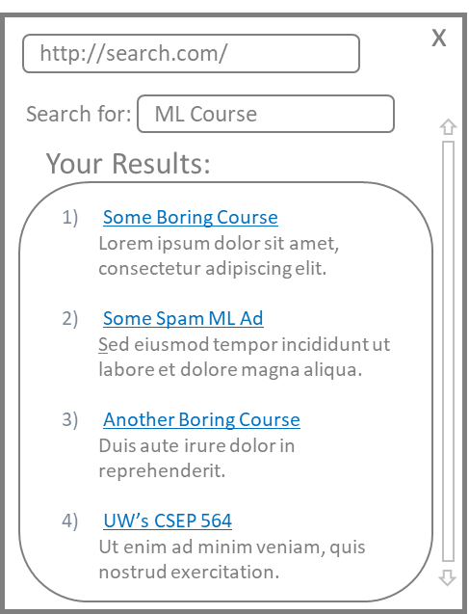
Ranking Flow
Text
Speech
Movie
Product
Content
Topic
Parameters
Augmentation
Query Triggering
Query Engines
Query
Interpretation
Query
& Planning
Interact
Best
Answers
Task Specific Solutions
Domain Specific Answers
Focused (or Legacy) Indexes
Ranker
Top N
Answers
Maximize objective
History, user, context, etc…
User Experience

Slide 4
One way of Evaluating Ranking: Mean Average Precision
$$AveP(q)=\frac{\sum_{i=i}^{N}{({Precision}_{@i} ∗IsRelavant\left(i\right))}}{\#Relevant}$$
$$Q=Test Queries$$
A
A
$$(1.0 ∗1)$$
Scores from
Ranking Algorithm
.5
$$MAP= \frac{\sum_{q∈Q}{AveP(q)}}{|Q|}$$
$$+$$
A
B
$$(0.5 ∗0)$$
.9
$$+$$
B
C
$$(0.33∗0)$$
$AveP=\frac{1.5}{2}$ = 0.75
A
.8
$$+$$
Query
B
A
$$(0.5∗1)$$
.2
$$+$$
C
C
$$(0.4∗0)$$
.4
$$+$$
Many other options:
Mean Reciprocal Rank
Precision @k
Clickthrough Rate
User Outcomes
And etc…
C
B
$$(0.33∗0)$$
.7
If:
Possible
Answers
Ranked
Answers
Ranker put both As @ top $AveP=1$
Ranker put both As @ end $AveP\sim .18$

Slide 5
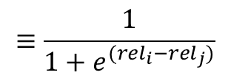
Ranking algorithm sketch (RankNet)
$$≡\frac{1}{1+e^{(rel_{i}−rel_{j})}}$$
Training data:
Set of: Query → $\{<item_{1}, rel_{1}>,$ $…,$ $<item_{n},rel_{n}>\}$
While not converged:
Iterate over training data
Apply current model to all items
For every pair of items, $i,j$
Adjust the model weights to make them ‘more correctly ordered’
$$P_{ij}≡P\left(item_{i}⊳item_{j}\right)$$
$C=−{\overline{P}}_{ij}\log{P_{ij} −(1−}$ ${\overline{P}}_{ij})\log{(1−P_{ij})}$
1 if i should rank above j else 0
https://www.microsoft.com/en-us/research/wp-content/uploads/2016/02/MSR-TR-2010-82.pdf

Slide 6
Getting Training data for ranking models
Corpus Centric
Sample queries from the system and:
Pay labelers to find relevant (good) answers
Pay labelers to grade the responses the system gives
Do Active Learning
Closed Loop
Record the interactions users have
Click through rate
Outcomes they achieve
Explore for ranking training
$ε$ greedy – show a random answer $ε$ percent of the time
Explore for query engine training
$ε^{2}$ greedy – let random engine show random answers some percent of the time

Slide 7
Where the Models Live
Query Triggering:
Latency
Privacy
Data Cost
Text
Speech
Movie
Product
Content
Query Engines
Query
Interpretation
& Planning
Query
Interact
Best
Answers
Query Engines:
Large Data Indexes
Analysis and Interpretation
Ranker
Top N
Answers
History, user, context, query results, etc…
User Experience

Slide 8
What does it matter where intelligence lives?
Latency in Updating
Quality is evolving quickly
Problem is evolving quickly
Risk of costly mistakes
Latency in Execution
Slowing the experience
The right answer changes too fast
Cost of operation
Cost of distributing intelligence
Cost of executing intelligence
Offline operation
Work without Internet?
Keep it out of Abuser’s hands…
PRIVACY

Slide 9
Where Intelligence Lives
Lives in Service
Lives on Client
1 MB Model
Daily Update
100k Users
100kb/Call
10 Calls/Day
1 mb x 1
Intelligence
Creation
Intelligence
Creation
Server
1 mb x 100,000
Server
100kb x 10 X 100,000
Telemetry
Clients
Clients
Total: 100,001 mb + compute
Total: 100,000 mb + Telemetry
Notes:
Let's go through a simple comparison between hosting intelligence in the client and in a service.
Let's say you have a 1MB model file and to balance out your Intelligent System you determine you need to update this model once a day.
If you want to run the intelligence on a server you'd have just 1MB per day to transfer the model files between servers.
But then you'd need to deal with all the intelligence executions. Say you have 100,000 customers. Maybe each customer interacts with the intelligence 10 times per day, and each intelligence call includes 100KB of data (maybe an image), and you have to use CPU on your server to process everything... 100,001 MB plus compute.
If you want to run on the client you have to transfer new model files to them every day,100GB a day. Then do a bit of work to gather telemetry. But executing the intelligence is cheaper and has lower latency.
About a wash in terms of cost. But there are clearly many options with some big implications.
And once you get everything balanced perfectly, someone is going to come to you and say "Hey, our system is making some bad mistakes, so we have to update the intelligence faster, once per hour instead of once per day -- sound good?“
If your implementation is flexible, you can accommodate and you'll have more options for achieving the Intelligent System's objectives. If not? Well, you’ll have to figure out how to achieve balance some other way, like by making the experience less forceful.

Slide 10
Places Intelligence can Live
Where it Lives | Latency in Updating | Latency in Execution | Cost of Operation | Offline?
Static in Product | Poor | Excellent | Cheap | Yes
Client Side | Variable | Excellent | Based on update rate | Yes
Server-Centric | Good | Internet Roundtrip | Can be high | No
Back-end | Variable | Variable | Variable | Partial
Hybrid | ?? | ?? | ?? | ??

Slide 11
Where the Models Live
Query Engines
Query
Query Engines:
Hybrid
Backend: Cache common queries
Server Centric: Tail queries
Query Triggering:
Client Side
Reduce server traffic
Preserve user privacy
Ranker
Ranker:
Server-centric – if heavily query-engine-confidence focused
Client Side – if simple & heavily user sensitive

Slide 12
Examples of Where Intelligence Lives
Kinect
Anti-Phishing
Online Shopping
Self-Driving Car
Sprinkler Controller
Composition Assistant
Latency in Updating | Not Important
Latency in Execution | Critical
Cost of Operation | Not Key Factor
Offline Operation | Important
Solution (?) | Client Centric
Latency in Updating | Important
Latency in Execution | Critical
Cost of Operation | Important (?)
Offline Operation | Critical
Solution (?) | Client Centric
Latency in Updating | Critical
Latency in Execution | Medium Important
Cost of Operation | Important
Offline Operation | Not Important
Solution (?) | Hybrid (ALL)
Latency in Updating | Slow Okay
Latency in Execution | Not Important
Cost of Operation | Important (?)
Offline Operation | Critical
Solution (?) | Backend (Cache)
Latency in Updating | Medium Important
Latency in Execution | Very Important
Cost of Operation | Very Important
Offline Operation | Not Important
Solution (?) | Server / Backend
Latency in Updating | Slow Okay
Latency in Execution | Important
Cost of Operation | Important (?)
Offline Operation | Important
Solution (?) | Server / Client

Slide 13
Deploying and Lighting Up (Online Evaluation)
Single Deployment
All users see all updates ‘at once’
Simple
Relies on great offline tests
Risk of costly/hard-to-find mistakes.
Silent Intelligence
Run two versions at once
Ensure online is same as offline
Gives time to see ‘new’ contexts
Latency. No interactions.
Controlled Rollout
Several live at once, transition slowly
Lets you observe user interactions
Overhead to build and manage
Adds latency.
Flighting Intelligence (A/B test)
Deploy options, track till one better
Connects accuracy to true objective
Overhead to build and manage
Latency. Hard to confirm small gains.

Slide 14
Summary Ranking Based
Ranking sorts possible responses in the correct order based on a query
Loss metrics for ranking include:
Mean Average Precision
Mean reciprocal rank
Precision @k
Clickthrough rate
Outcomes
And more…
Choosing where your models lives can have a large impact on cost / effectiveness, options include:
Static
client side
server centric
back end
hybrid
Ranking can be used corpus centric or with a closed loop

